Slide 1
Text Summarization Using RNN
-Group D:
Deepak Shukla
Naina Jain
Pranav Deeshpande

Slide 2

Motivation
News Headlines/ Bulletins
Outlines Of Notes
Minutes Of A Meeting
Movie Previews
Book Reviews
Abridgment Of Books
Sound Bites (Politicians On A Current Issue)
Histories (Chronologies Of Salient Events)

Slide 3
Two Types :
Extractive Summarization
Model selects passages from the source text and then arranges it to form summary
Abstractive Summarization
Model understands the intent and rephrases summary

Slide 4
Problem Statement:
Customer reviews are long and descriptive. Hence Time consuming
Formally:
Our objective here is to generate a summary for the Amazon Fine Food reviews using the abstraction-based approach

Slide 5
Dataset:
Amazon Fine Food reviews
Span : 10 years, up to Oct 2012
Records : ~500,000 reviews
Includes:
product and user information
Ratings
plain text review
summary

Slide 6
Pre-processing:
Drop the:
Duplicates
NA values
Unwanted symbols and characters
Stop-words
Short words
Contraction mapping

Slide 7

Tokenize:
Analyze length of reviews and summary
Majority review length = 80
Majority summary length = 10
Fix maximum review and summary length accordingly

Slide 8

Neural Network Layers used in project
RNN Layer(LSTM model)
Embedding Layer
Time Distributed Layer
Attention Layer
Dense Layer

Slide 9

LSTM(Long Short-Term Memory)

Slide 10
Why LSTM?
Flashback: Recurrent Neural Networks (RNN)
Achieved time-dependency (Stock prediction)
Effective for short-term dependencies only
Vanilla RNNs fail to understand context behind an input

Slide 11
Dependencies
Previous cell state (information present in memory after previous time step)
Previous hidden state (output of previous cell)
Input at current time step (the new information)

Slide 12

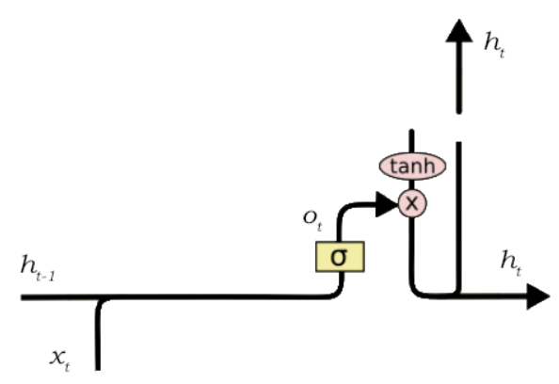
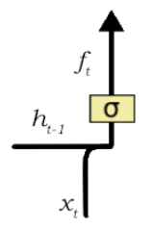
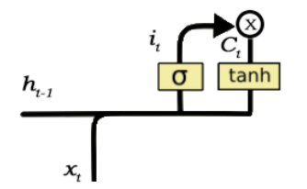
Architecture:
Forget Gate
Input Gate
Output Gate

Slide 13
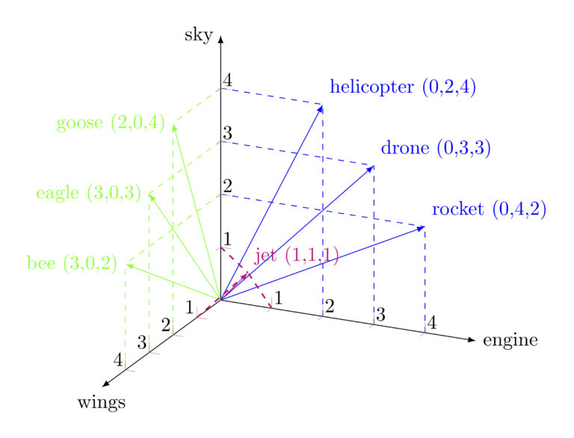
Embedding Layer:
“Turns positive integers (indexes) into dense vectors of fixed size.”
keeps distance between related words less and contradicting words more
allows visualization relationship between words.

Slide 14
Dimension Selection
Why?
Lower dimension inversely affect the results
Higher dimensions can slow down the execution
Rule of thumb:
Embedding dimensions = number_of_words ** 0.25
Training vocab size = 32392

Slide 15
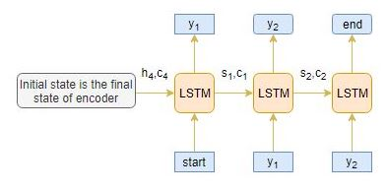
RNNs can easily translate a word from a given language to some other language by using the word mapping. In RNN the last hidden state from Encoder is fed as an input to the Decoder. Attention Layer is used to improve the performance of the model.
Attention Layer

Slide 16
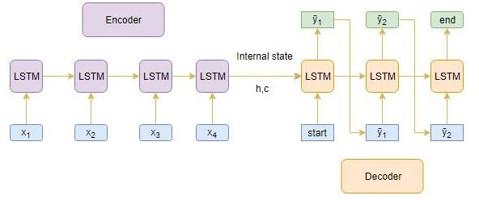
WORKING:
Allows network to focus on some part of the input when it is producing the output
Compares hidden states of each word to find the closest distance
Each hidden state of input (h) is measured with the output state(s).
Closest representation is given more weight.
Selected word is given as an output.

Slide 17
Time Distributed Layer
Dense layer responsibility : Activation(dot(input, weight)+bias))
Combines output from decoder layer perform and activation on it
But output of decoder is a sequence of vector and each vector maps to single word and we want to find the best word fits to the vector, so we want to process one by one vector.
Time distributed layer does that for us.
Time Distributed layer apply the same layer to several inputs and it produce one output per input to get the result in time.

Slide 18
Encoder-Decoder Framework
Framework used : Seq2Seq

Slide 19
Architecture

Slide 20
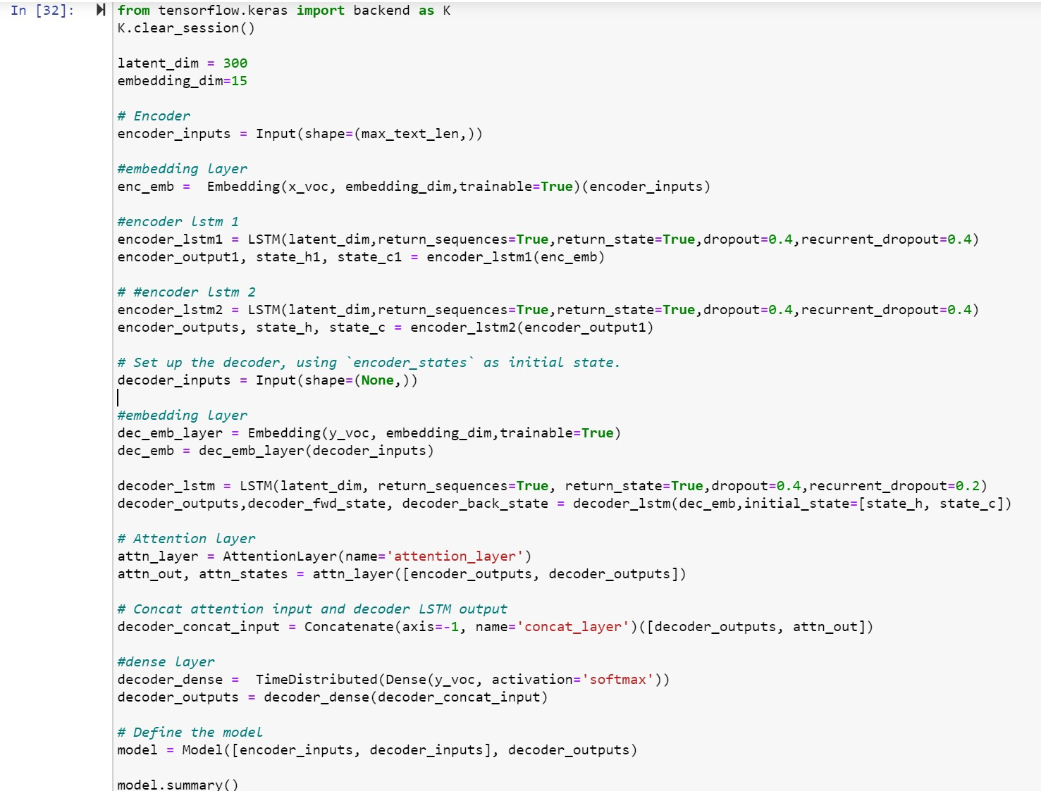
Code Snap :

Slide 21
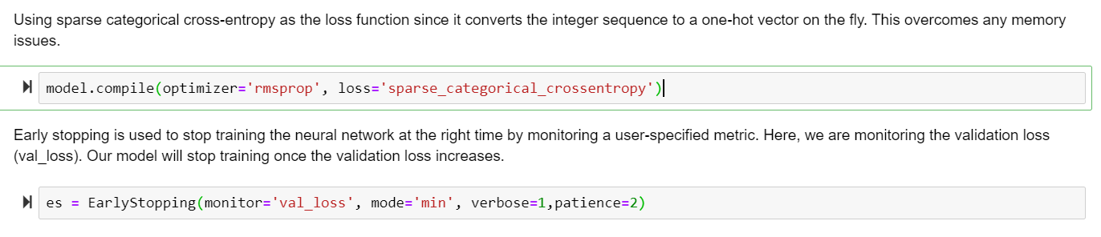
Loss Function and Early Stopping

Slide 22
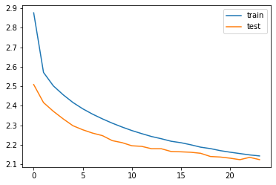
Experiments:
We created 3 models :
Model 1:
1 LSTM layers in Encoder
1 LSTM layer at Decoder
1 Attention layer
Model 2: (Overfitting Observed)
2 LSTM layers in Encoder
2 LSTM layers in Decoder
1 Attention layer
Model 3: (Optimum performance)
2 LSTM layers in Encoder
1 LSTM layer at Decoder
1 Attention layer

Slide 23
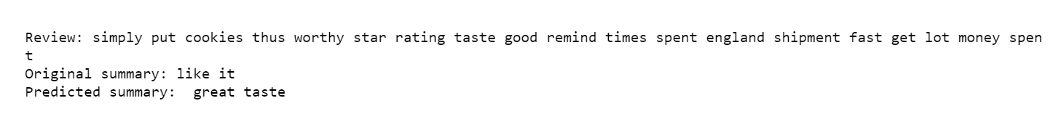
Output:

Slide 24
Future Scope:
Bi-directional LSTM can be implemented that captures the context from both the directions.
Search Beam strategy can be implemented for decoding text sequence.
Evaluate performance of the model using BLUE scores.

Slide 25
Thanks!

